Slide 1

WasteWise Toronto
The Smart Waste Sorting
Application
Group #2’s Team members:
1. Ivy Tsai
2. Jeffrey Ching Lok Ng
3. Fatima Aghapourasl
4. Penelope De Freitas

Slide 2
Agenda
01 Project Overview
02 Problem & Significance
03 Business Opportunity
04 Business Requirements
05 ML Canvas
05 Project Pipeline
06 Datasets & Sources
07 Experimental Environ & Limits
08 Data Exploration & Augmentation
09 Presentation of Findings
10 Challenges, Conclusions & Future Steps
11 Demo
12 Data Sources & References

Slide 3



What is Waste Sorting in Toronto about?
Black Bin
Blue Bin
Disposes of non-recyclable waste.
Recycles plastics, metals, glass, and paper
Green Bin
Composts organic waste

Slide 4
Project Overview
Our project introduces a smart, user-friendly solution to the complex problem of waste management.
By integrating advanced machine-learning techniques, we're empowering citizens to make eco-conscious waste disposal decisions effortlessly.
WasteWise Toronto is poised to become an indispensable tool for Toronto households, making sustainable living a cornerstone of modern urban life.

Slide 5
Problem & Significance
Urban waste to rise from 2.01 billion tonnes in 2016 to 3.40 billion tonnes by 2050 (WHO, 2024).
Toronto's waste projected to increase from 2.1 million tons to 2.5 million tons by 2030 (Circle Economy, 2022).
Consumers face several barriers when it comes to sorting waste such confusion in deciding on appropriate recyclable materials and lack of waste sorting guides (Mielinger & Weinrich, 2023; Roy et. al, 2022).

Slide 6



Business Opportunity - Examining Existing Solutions
Assessment Areas | TOwaste (Toronto) | WasteWise (Edmonton)
Collection Schedules
Waste Sorting Guide
Notifications
Drop-off Depots
AI-powered features
Customer Ratings (Google Play Store) | 3.6 out of 5 (259 reviews) | 4.8 out of 5 (5000 reviews)
Static
Information
Notes:
Toronto's current tools provide:
only static information
lacking the dynamic assistance.
WasteWise is here to change that with AI-driven guidance to clear up recycling rules, simplify the sorting process, and foster environmental responsibility. This is not just for Toronto—WasteWise has the potential to innovate waste management on a larger scale.

Slide 7
Business Requirements
Funding: Acquiring seed money and investor support to fund a team of developers, testers, and designers.
Technical Resources: Utilizing advanced AI technologies and ensuring app compatibility across devices.
Cloud Hosting: Implementing scalable, reliable cloud infrastructure to handle user demands.
Human Talent: Hiring skilled personnel for development, management, and innovation.
Legal Compliance: Adhering to Toronto's licensing, data protection laws, and credit for data sources.
Transparency and Trust: Conducting regular audits and clearly communicating data policies to users.

Slide 8
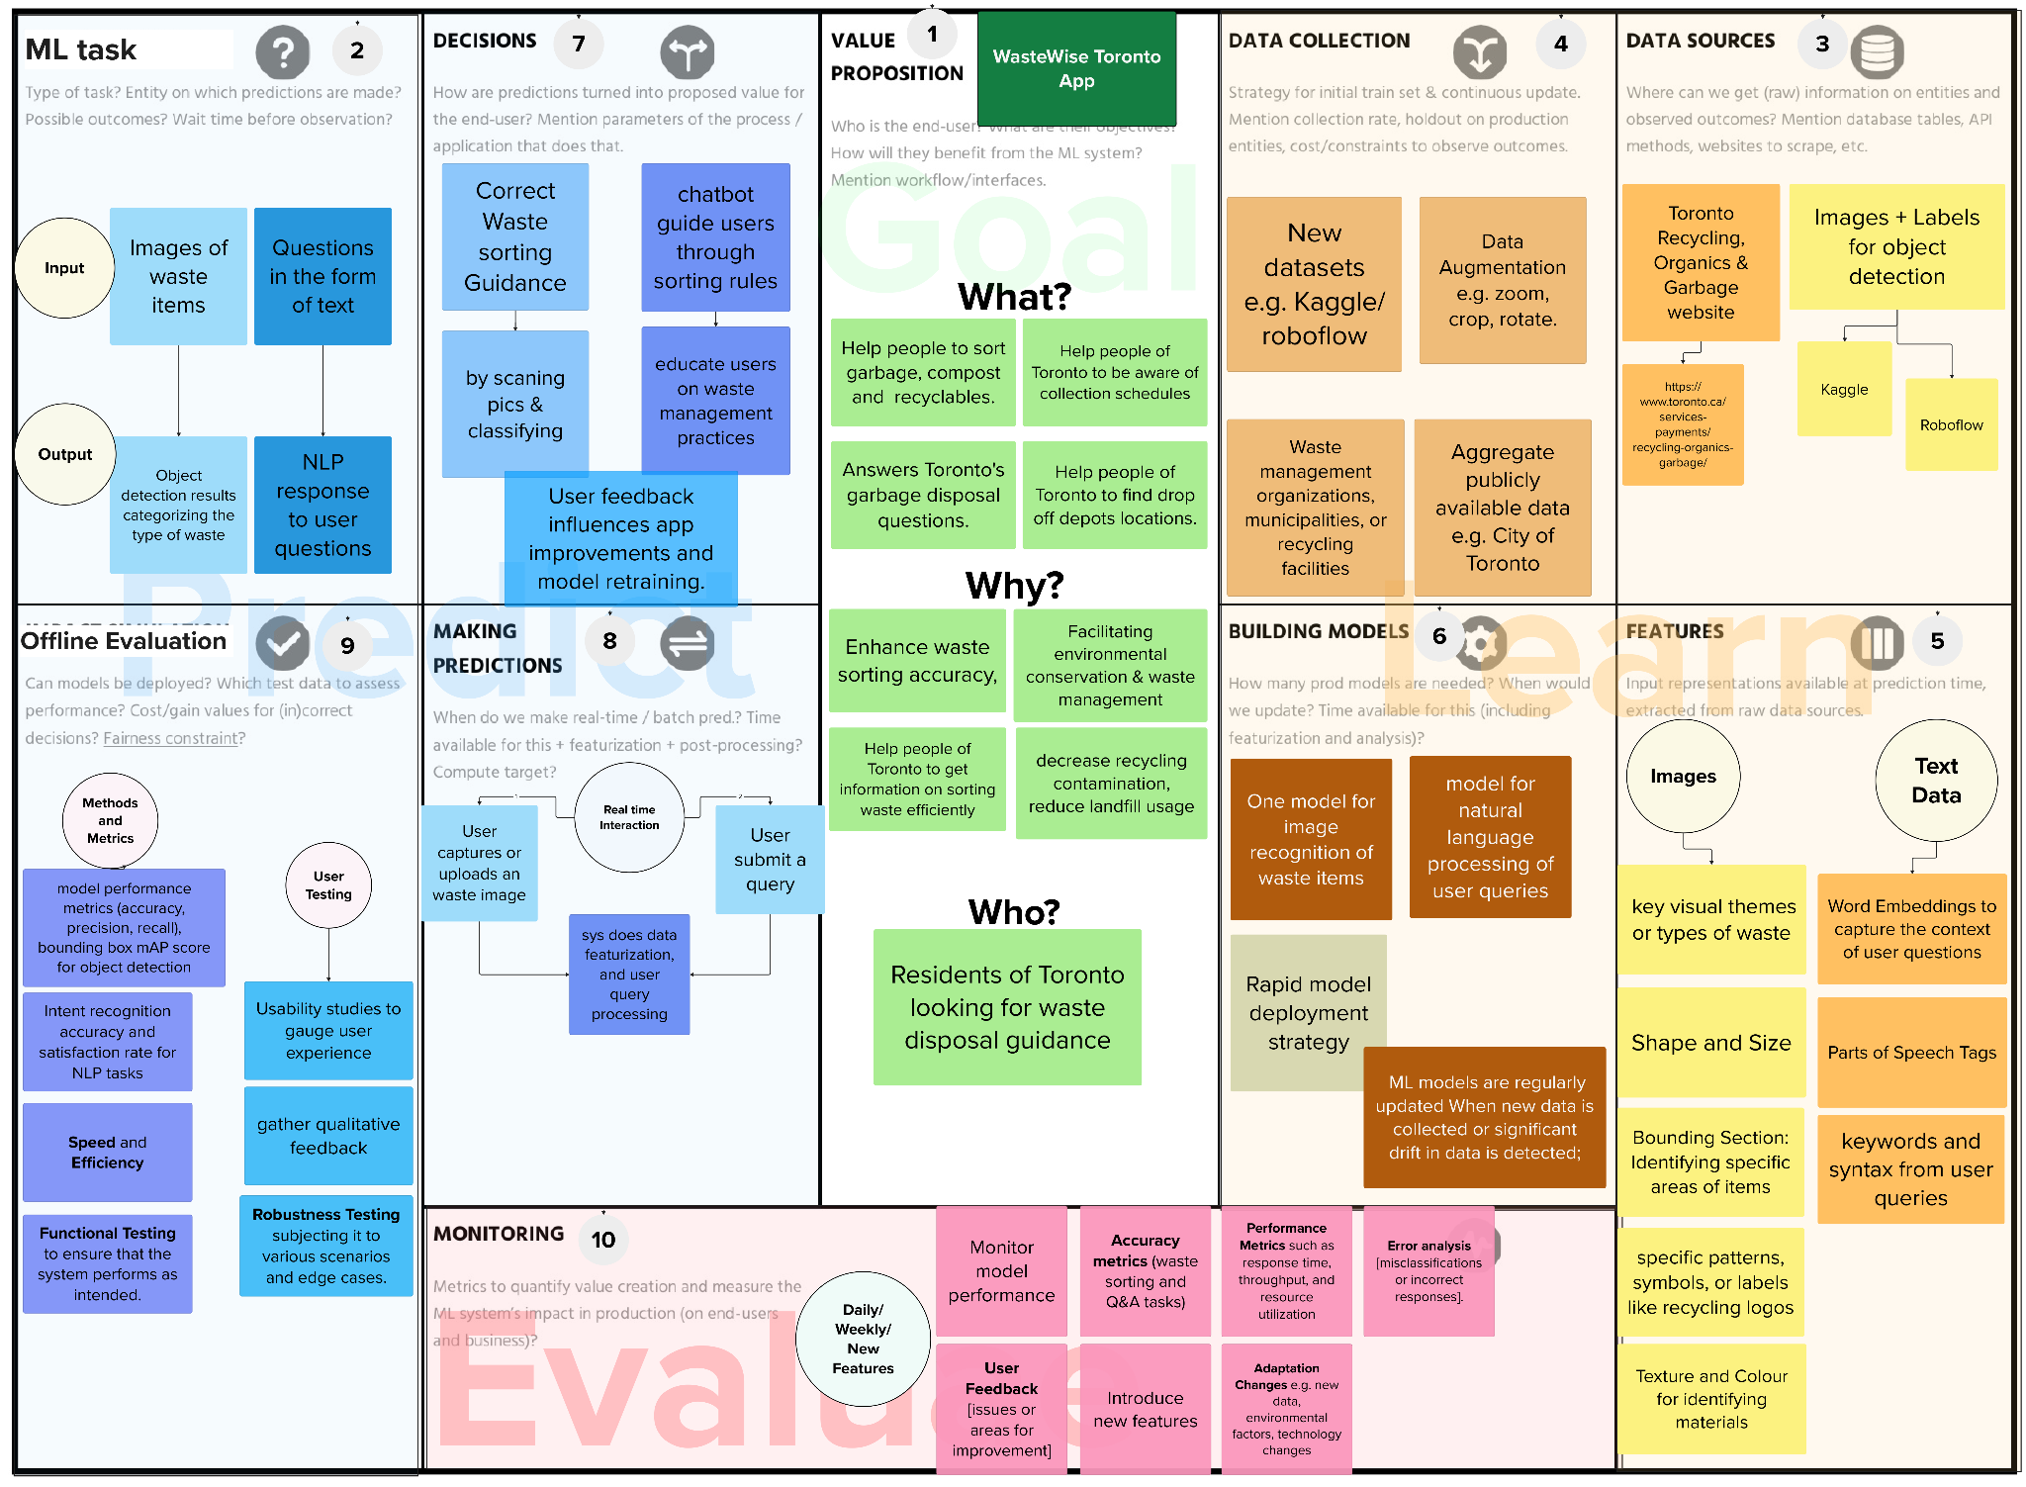
ML
Canvas

Slide 9
WasteWise Toronto - Project Pipeline
Mixed Images of Waste
Direct Downloads
Fine-tune Waste Detection Model
Data
Preprocessing
Textual Waste Information
Content
Scrapper
Fine-tune Chatbot Model
Design + Build UI of Mobile App
WasteWise App
Host Flask endpoints on AWS
Flask script
Python script

Slide 10
Experimental Environment and Limits
Experiment’s Environmental conditions:
Google Collab, T4 GPU
Kaggle, T4 GPU
Anaconda
Ionic (mobile app), hosting on AWS (Flask)
Limitations:
The models were trained on a limited classes (11) and quantity (4800 images) of waste and textual information dataset
Mobile app can handle 1 waste item per image as input
Images were based on fixed lighting conditions, hence images taken in poorly lit environments presents a challenge
Hypertuning parameters: Continuously monitor model performance in production and gather feedback from end-users
‹#›

Slide 11
Datasets & Sources
The heart of WasteWise Toronto is its data-driven intelligence, fueled by diverse datasets and credible sources. We've meticulously curated a rich repository:
Images + Labels for object detection (11 classes, Creative Commons Attribution 4.0 International License):
Roboflow
Kaggle
Textual information for chatbot:
City of Toronto’s website
class_names: ['cans', 'tins', 'metal_trays_plates_pans','cardboard', 'styrofoam container', 'envelope', 'paper', 'carton', 'plastic', 'organics', 'general']

Slide 12
Data Exploration & Augmentation
Images for object detection (11 classes):
[blue bin] ¬2100+ were recyclables [green bin] ¬2100+ were organics
[black bin] ¬2100+ were general or non-recyclable
Roboflow:
Auto-orientation of pixel data
Resize to 416x416
50% probability of horizontal and vertical flip
90-degree rotations: clockwise, counter-clockwise
Shear -15° to +15°: horizontally and vertically
Notes:
In the data exploration phase, we delved into the nuances of our datasets, uncovering patterns and insights that inform our model development. Through augmentation techniques, we've expanded our datasets to be representative of various scenarios, ensuring our application can reliably guide users across a broad spectrum of waste items and conditions.

Slide 13
Model Selection
Object Detection Model
YOLOv8n over YOLOv5 was chosen because it may offer a good balance between speed and accuracy
Availability of help and documentation resources and community support
Chatbot Model
Gemini from Google chosen because of its ability to understand texts and free API access.
Fine tuned using LangChain by using RAG over the webpages in the City of Toronto

Slide 14
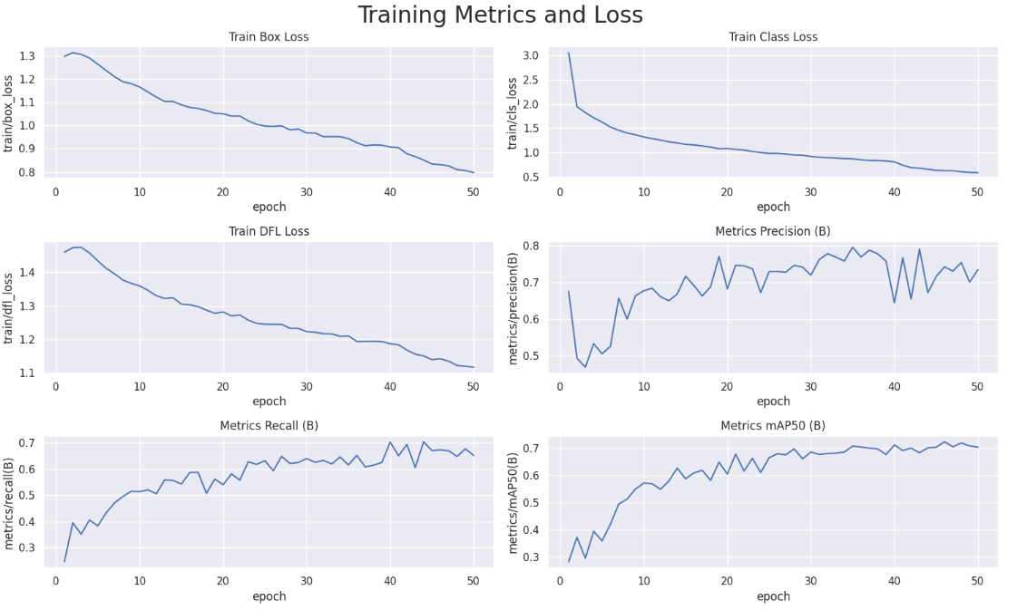
Findings: YOLOv8n [Waste Detection]
Predictions based on Image Labels (class and bounding boxes)
Hyperparameter Tuning
Epochs: (10, 20, 50)
Batch sizes: (8, 16, 32, 64)
Learning rates (lr0): (0.001, 0.0003, 0.0001)
Dropout: (0.15, 0.25)
Drop in class loss (from 3.058 to 0.5856)
Training time of 0.5 to 1 hours on GPU

Slide 15
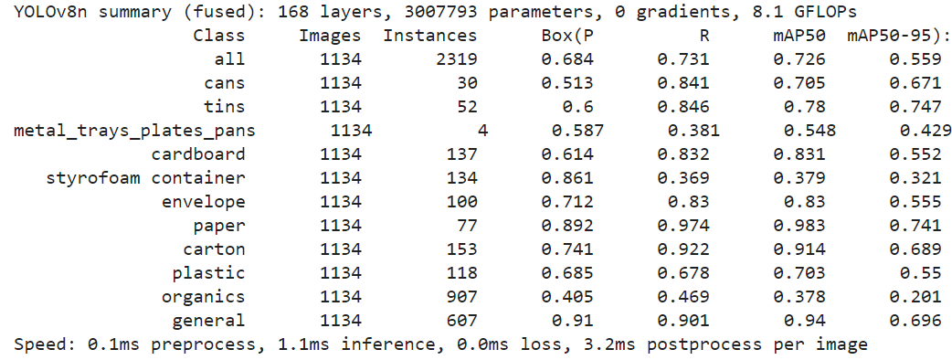
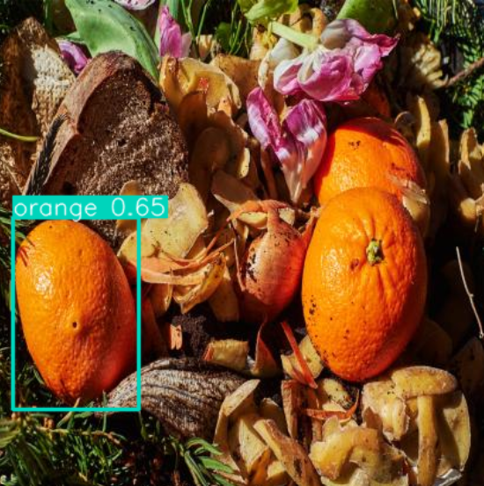
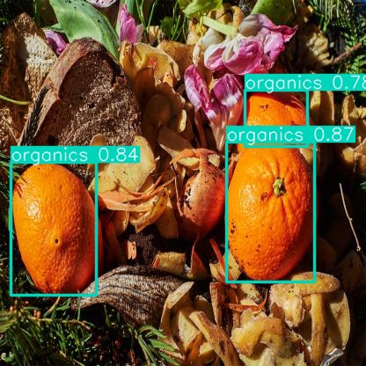
Findings: YOLOv8n [Waste Detection]
Performance:
Overall Precision: 72.6%
Best classes (mAP):
Carton, Paper, Cardboard Plastic, Can, Tin, General
Inferencing:
Base Model: 65%, orange
Fine Tuned Model: 78% - 87%, organics

Slide 16
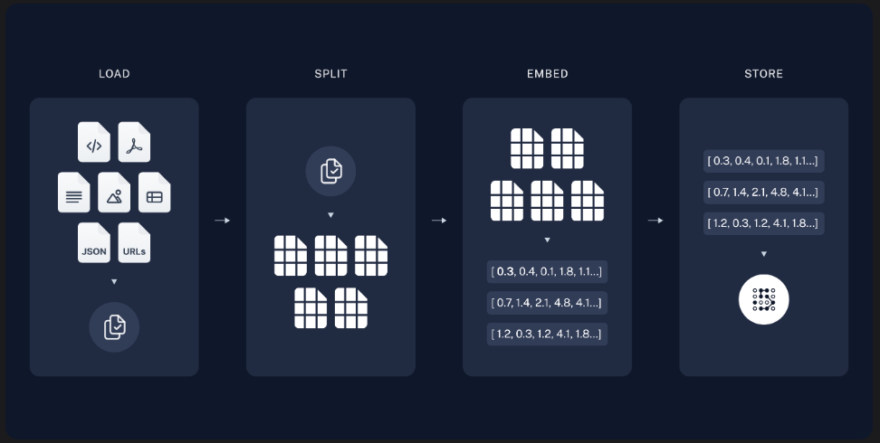
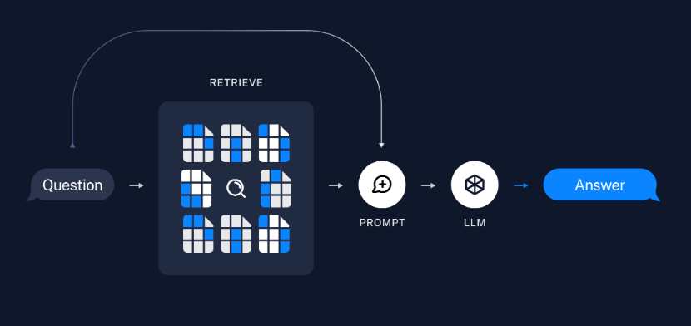
RAG: Gemini from Google [Chatbot]
Our source documents for the RAG Chain was directly scraped from the City of Toronto website, and stored in a chromadb vectorstore using Google’s GenAI embeddings
Turned the vectorstore to a retriever and use the retriever in the RAG Chain
Created a custom RAG prompt to add additional context the chatbot may not know, and isn’t part of the documents.
Indexing
Retrieval and Generation

Slide 17
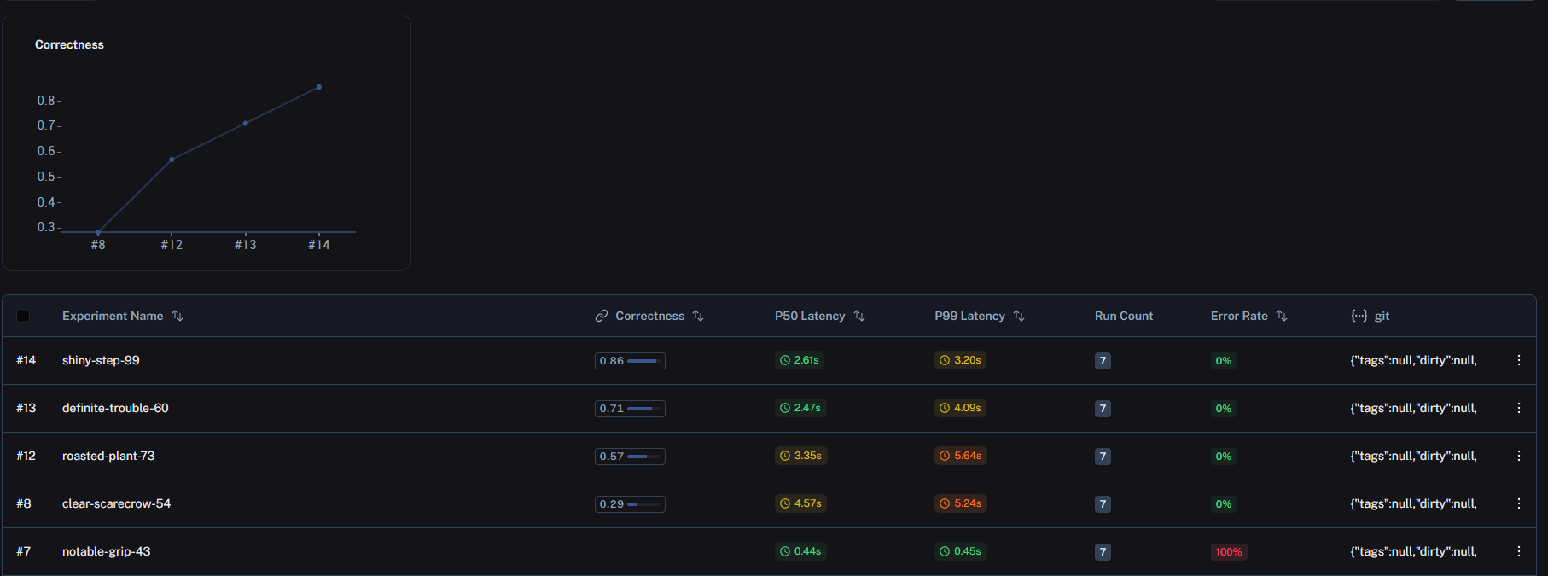
Findings: Gemini from Google [Chatbot]

Slide 18
Future Improvements: Gemini from Google [Chatbot]
Ensure consistent answers
Maybe due to the inconsistent formatting from scraping text data off the website
Reformat the documents by collecting data as a pdf instead of webpage, and allowing the use of images information
Use newer LLM models that have better performance

Slide 19
Challenges
Data Complexity:
Overcoming data diversity and quality issues to train robust ML models.
Image acquisition and preprocessing was time-consuming
Integration: Ensuring seamless integration of advanced technology within a mobile app.

Slide 20
Conclusions and Future Work
Educational Impact: Increases awareness and proper waste disposal practices.
Proven Impact: The integration of ML and AI has improved waste sorting accuracy and enhanced user engagement
Expand Dataset: Enrich the variety and quality of data to enhance model accuracy.
Scale Operations: Extend the app’s reach to new cities and regions, adapting to local waste management protocols.
Enhance Features: Develop additional functionalities such as community-driven updates , drop out depots and schedule and more personalized user interactions.

Slide 21

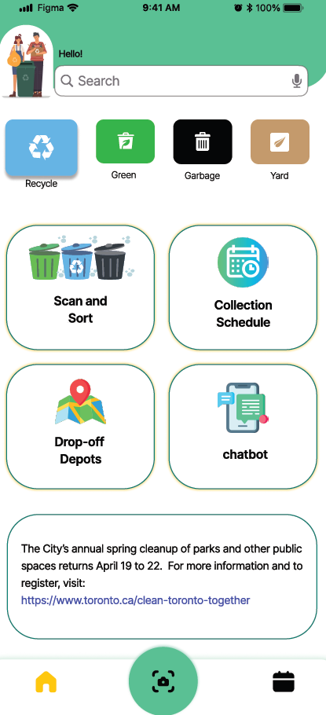
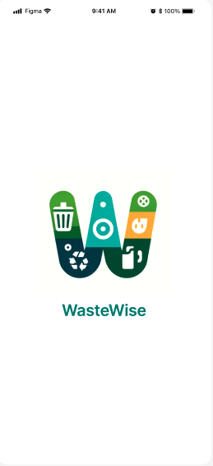
App Demo

Slide 22
Thank you!

Slide 23
List of Data Sources
Blue Bin:Recyclables
Metals ('cans', 'tins', 'metal_trays_plates_pans'): https://www.kaggle.com/datasets/sumn2u/garbage-classification-v2?select=metal
Cardboard boxes: https://universe.roboflow.com/dataset-t7hz7/cardboard-eupc8/dataset/3
Styrofoam containers : https://universe.roboflow.com/namseoul-qobk6/styrofoam-qt1kt/dataset/1
Envelopes: https://universe.roboflow.com/mateo-ojeda/envelope-c6750/dataset/1
Paper: https://universe.roboflow.com/natalie-perrochon-yqnhb/recycling-try-2/dataset/16
Carton juice and milk boxes: https://app.roboflow.com/waste-z6zen/carton-xuife/1
Plastic bottles: https://universe.roboflow.com/betul-rt4lp/plastic-bottle-cuwtu/dataset/1
Green Bin: Organics (fruits, vegetables, scraps from plates and garbage dumps, rotting foods)
https://universe.roboflow.com/patata-man-y8maj/bio-waste/browse?queryText=&pageSize=50&startingIndex=0&browseQuery=true
https://universe.roboflow.com/search?q=organic%20waste
Black Bin: General waste
mugs: https://universe.roboflow.com/gsa-team/mugs-vhjth
broken plates: https://app.roboflow.com/waste-z6zen/general-1/1
cigarettes: https://universe.roboflow.com/universitadellacalabria-icrla/cigarettebuttdetection-tlhei
Masks and gloves: https://universe.roboflow.com/sultana-almasoud/our_gp2

Slide 24
References
Canada.ca, 2009. Business Case Guide. https://www.canada.ca/en/treasury-board-secretariat/services/information-technology-project-management/project-management/business-case-guide.html
Circle Economy, 2022. Lessons from North America: How Toronto is going Circular. https://www.circle-economy.com/blogs/lessons-from-north-america-how-toronto-is-going-circular
Edmonton.ca, 2024. WasteWise app. https://www.edmonton.ca/programs_services/apps_mobile/wastewise-app
Mielinger, E., & Weinrich, R. (2023). A review on consumer sorting behaviour: Spotlight on food and fast moving consumer goods plastic packaging. Environmental Development, 100890.
Office of the Privacy Commissioner of Canada. 2018. PIPEDA legislation and related regulations. https://www.priv.gc.ca/en/privacy-topics/privacy-laws-in-canada/the-personal-information-protection-and-electronic-documents-act-pipeda/r_o_p/
Roy, D., Berry, E., & Dempster, M. (2022). “If it is not made easy for me, I will just not bother”. A qualitative exploration of the barriers and facilitators to recycling plastics. Plos one, 17(5), e0267284.
Toronto.ca, 2024. TOwaste app. https://www.toronto.ca/services-payments/recycling-organics-garbage/towaste-app/
World Health Organization, 2024. What a Waste 2.0. https://datatopics.worldbank.org/what-a-waste/#:~:text=As%20nations%20and%20cities%20urbanize,through%20open%20dumping%20or%20burning.

